Slide 1
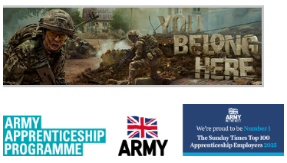
Supporting Your Young Person: Exploring a Career in the British Army
Tuesday 28 April | 18:00 – 19:00 | Online
We’re hosting a free online session for parents and guardians to provide clear, trustworthy guidance on how they can support their young person if they’re considering the British Army.
Why does this session matter?
Recent research with over 600 parents and guardians showed that only 27% felt fully confident supporting their young person through the Army application process. This session is designed to help change that by bringing reliable information together in one place.
During the session, parents and guardians will:
Get a simple overview of the journey into the Army
Hear from other parents
Learn about the support available, including:
  Brand new parent-focused resources
  Opportunities to sign up to our monthly newsletter
  A new webpage designed specifically for parents and guardians
If parents or guardians want to feel more informed and confident about the options available, we’d love them to join us. Teachers are also welcome to attend to support their understanding and conversations with families.
👉 Register for the event: https://britishar.my/AParentsPerpectiveEvent
Get the latest Army Careers info and resources
REGISTER YOUR INTEREST

